Slide 1
Computer Network Design for Building of the Bank

Slide 2
Our team!
Phu Nghia
Hai Dang
Hoang Minh
1952355
1952652
1952845

Slide 3
Table of contents.
Overview - 01
05 – Packet Tracer
Requirements analysis - 02
06 – System testing
Equipment & diagram - 03
07 - Result
Calculation - 04
08 - Conclusion

Slide 4
Overview
01

Slide 5
Design a computer network for a headquarter and two branches of a BBB (BB Bank) being under construction

Slide 6
Requirements analysis
02

Slide 7
Requirements
Functional
Headquarters: 7 floors, 1st floor has IT room and Cabling Central Local, 100 workstations, 5 servers, 12 network devices
Branches: 2 floors, 1st floor has IT room and Cabling Central Local, 50 workstations, 3 servers, 5 network devices
3 separated local networks: 100/1000 Mbps connection, VLAN, …
2 leased lines (for WAN connections) and 1 ADSL (for Internet connection) with a load-balancing mechanism

Slide 8
Requirements
Non-functional
High security: prevent DDoS, SQL injection, etc
Robustness: highly available, occasionally back-up data
Scalability: add more devices
Balanced load: 80% at peak hours 9 a.m. - 11 a.m. and 15 p.m.-16 p.m.
Usability: Licensed and open-source software, office applications, client-server applications, multimedia, and database.
High upload and download capacity: server - 500 MB/day, workstation - 100 MB/day, WiFi-connected laptop - 50 MB/day
Teleworkability: VPN configuration
High growth rate: 20% in 5 years

Slide 9
Checklist
Planning
How many on-site devices (computers, servers, scanners, printers, etc.) will require a network card?
Which server-based applications (e.g. database, email) does the Bank need to run on the network?
What are the desired specifications of the servers the Bank intends to install on the network (e.g. amount of memory, processor speed, etc.)?

Slide 10
Checklist
Network hardware requirements
Do the hubs or switches have enough ports for the number of connections the Bank will require? Is there room for growth?

Slide 11
Checklist
Network design
What network topology will the Bank use?
Which network operating system will the Bank use?
Which type of cabling will the Bank use? Would a wireless network be suitable?
Where will the network cables be located?
Where will the Bank locate the following devices: servers, hubs, switches, printers, firewalls, routers, modems, etc.?

Slide 12
Checklist
Security, backup, and power
What security measures will the Bank be putting in place?
Does the Bank need to physically secure its servers (e.g. locking them away in cupboards)?
How will the Bank back up data on its network?
What is the capacity of the backup solution?
Is it capable enough to support all the data on the servers and network devices?
Does the backup solution have the capacity to grow as the data grows?
How frequently will files be backed up and how long will the Bank keep backup files?
Where will the Bank store backed-up tapes? Would it be fireproof safe? Or off-site? Or any other locations?
What devices will require an uninterruptible power supply (e.g. servers)?
Is there sufficient ventilation around the servers?

Slide 13
Area with high load
Floor 1 of the headquarters and the two branches where the servers are located. These zones are where large amount of data goes through since the servers have to execute many operations.

Slide 14
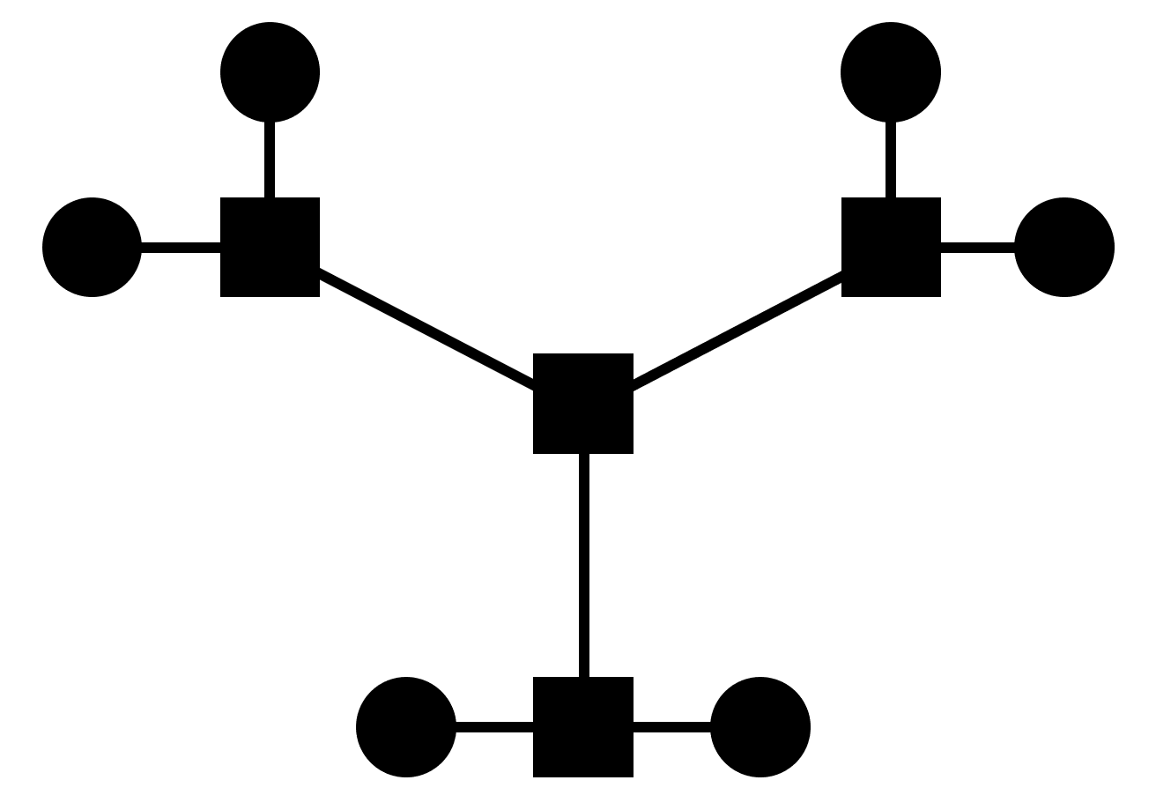
Network topology
Extended star topology

Slide 15
Network topology
Pros
Cons
Easy to setup, maintain, and monitor
Relatively inexpensive compare to full-mesh topology
Resilient to nodes and cables failure
Easy to scale up by adding more sub-central devices
High-performing since no data collisions can occur and data take shorter path compared to bus topology
Adding and removing nodes are easy
More redundancy than bus topology
More expensive than bus topology (more cables, more devices, etc.)
Sensitive to central/subcentral devices failure
The central device’s load is shared between nodes

Slide 16
WiFi coverage
Design for branches is similar to headquarters.
The network is designed for floor 1 and 2 of the headquarters and floor 1 of the branch where customers mainly use WiFi.
The wireless routers are directly connected to the gateway router so that it can act as the DHCP and provide the IP for wireless devices (smartphones, laptops).
Standard channel: 2.4 GHz.
WPA2-PSK with AES for the authentication method.
All devices that connect to WiFi networks cannot access the internal network.

Slide 17
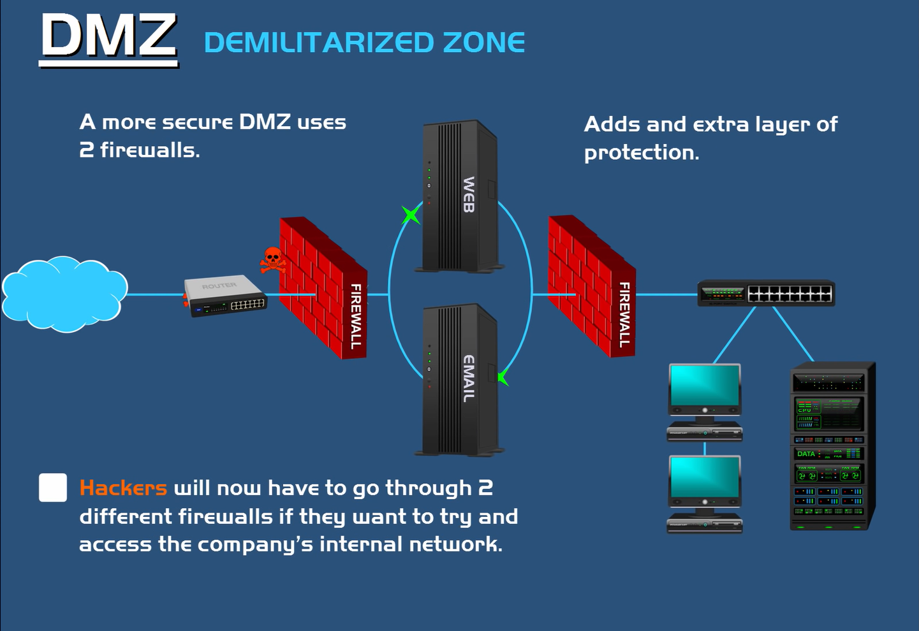
Security
Demilitarized Zone

Slide 18
Equipment & diagram
03

Slide 19
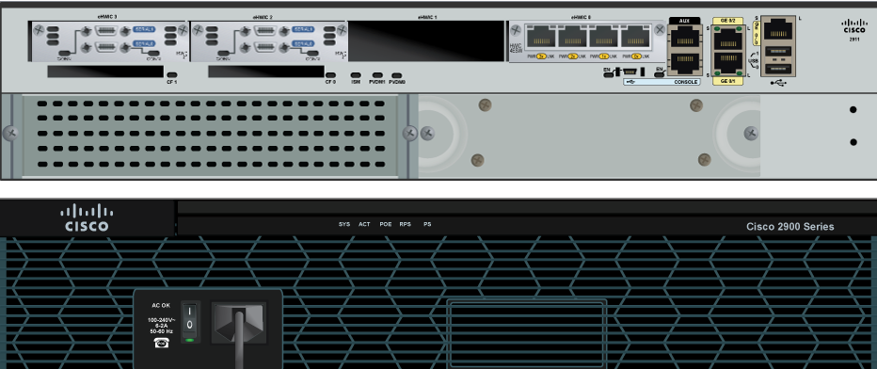
Recommended equipment
Router 2911
Quantity: 3
Specification: 3 Gigabit Ethernet Port, 2 Serial Port
Ethernet connects the switches and routers in the same area
Serial connects to devices in other areas

Slide 20
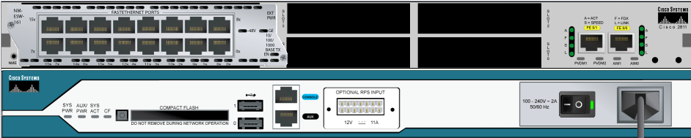
Recommended equipment
Router 2811
Quantity: 1
Specification: 18 Fast Ethernet Port
Used to connect from headquarter and branches to the internet

Slide 21
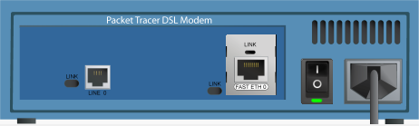
Recommended equipment
DSL modem
Quantity: 3
Specification: 1 Phone line port, 1 Fast Ethernet Port
Used to connect a network to a telephone company digital subscriber line (DSL) service for Internet access.

Slide 22
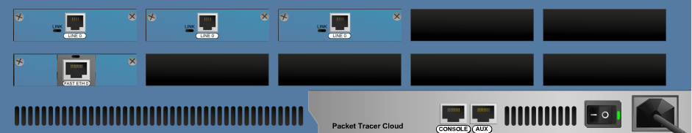
Recommended equipment
Cloud
Quantity: 1
Specification: 3 Modem port, 1 Fast Ethernet Port
The ISP connect to the internet can be represent as the cloud. We need cloud to have the phone line connect to the DSL modem. Some time we represent ISPs just a whole bunch of different routers that make up that cloud.

Slide 23
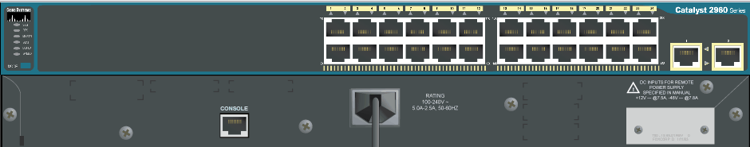
Recommended equipment
Switches 2960 24TT
Quantity: 15
Specification: 24 Fast Ethernet Port, 2 Gigabit Ethernet Port
For headquarter, we need 7 switches for 100 workstations, 4 servers, 1 DHCP server and growth rate of 20% in 5 years
For branches, we need 4 switches for each branch correspond to 50 workstations, 2 servers, 1 DHCP server and growth rate of 20% in 5 years

Slide 24
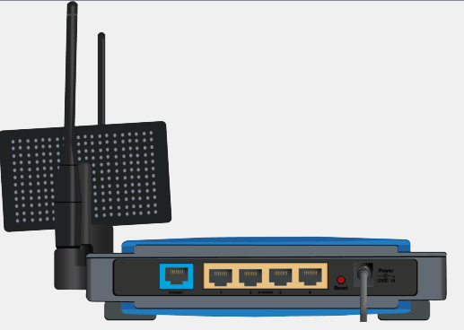
Recommended equipment
Wifi Router WRT300N
Quantity: 4
Specification: 2.4GHz channel WPA2-PSK built-in DHCP server
Provide wireless connection through WPA2-PSK authentication
In headquarter, we need 2 wifi routers for floor 1 and floor 2
In branch, we only need 1 wifi routers for floor 1

Slide 25
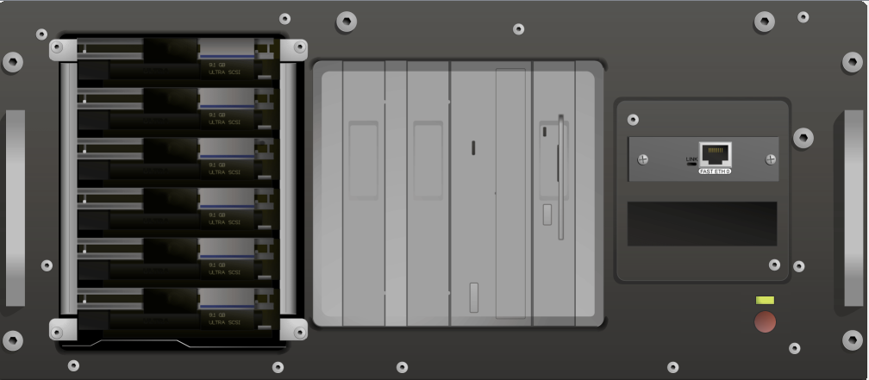
Recommended equipment
Server
Quantity: 11
Specification: 5 servers for Headquarter, 3 for each branch
To provide the DHCP services, each headquarter or branch will need 1 server for doing that

Slide 26
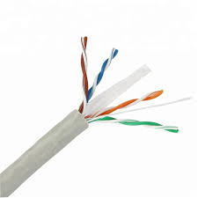
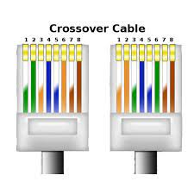
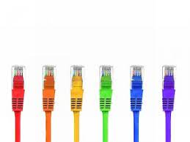
Recommended equipment
Cables
Straight-through copper cable
Crossover copper cable
Leased line cable

Slide 27
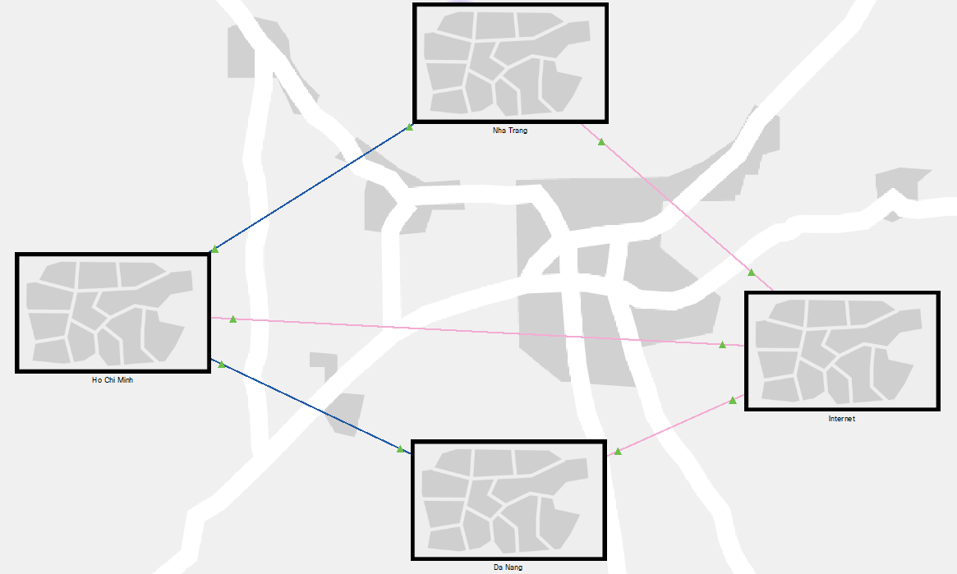
Schematic physical setup
Red: DSL connection
Blue: Leased lines

Slide 28
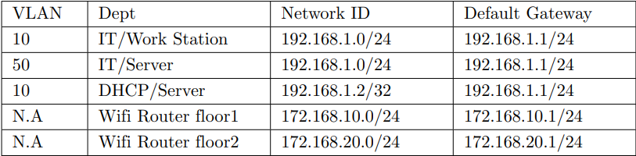
IP diagram
Headquarters

Slide 29
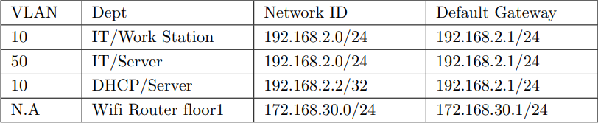
IP diagram
Nha Trang branch

Slide 30
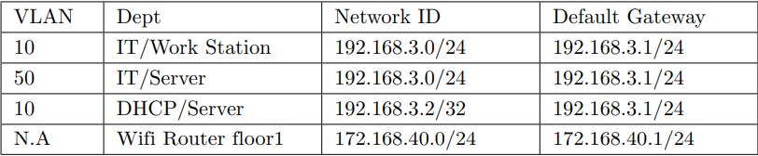
IP diagram
Da Nang branch

Slide 31
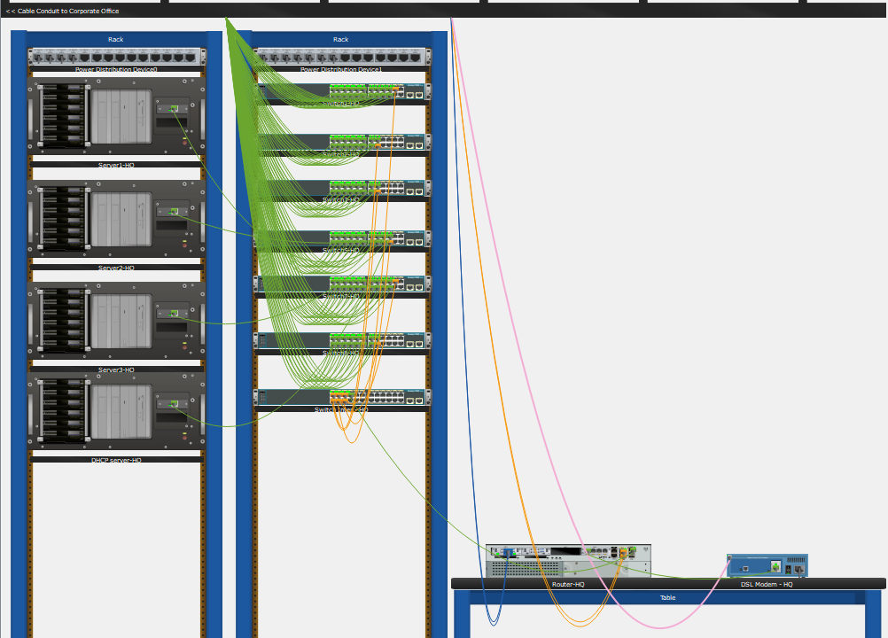
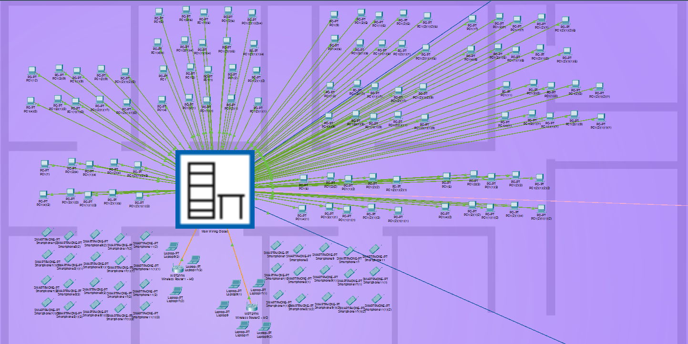
Wiring diagram
Headquarters

Slide 32
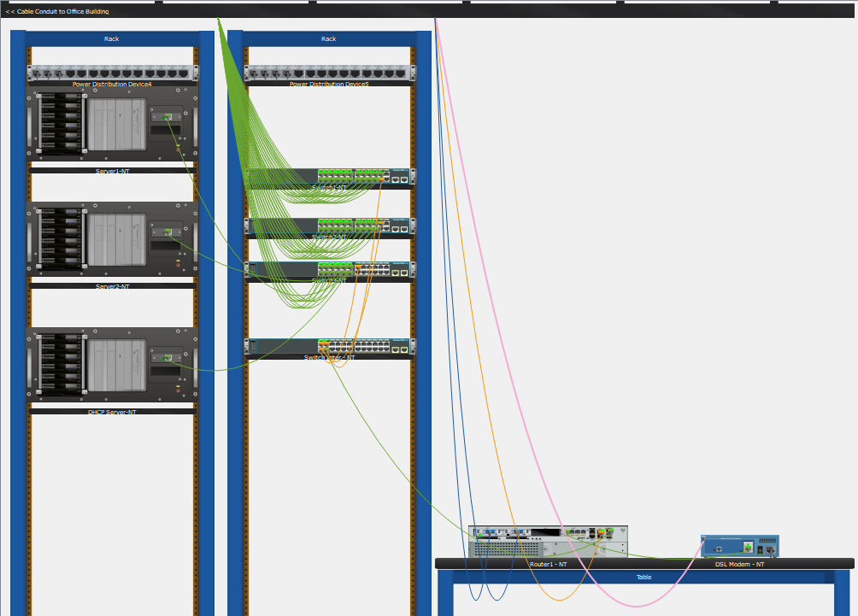
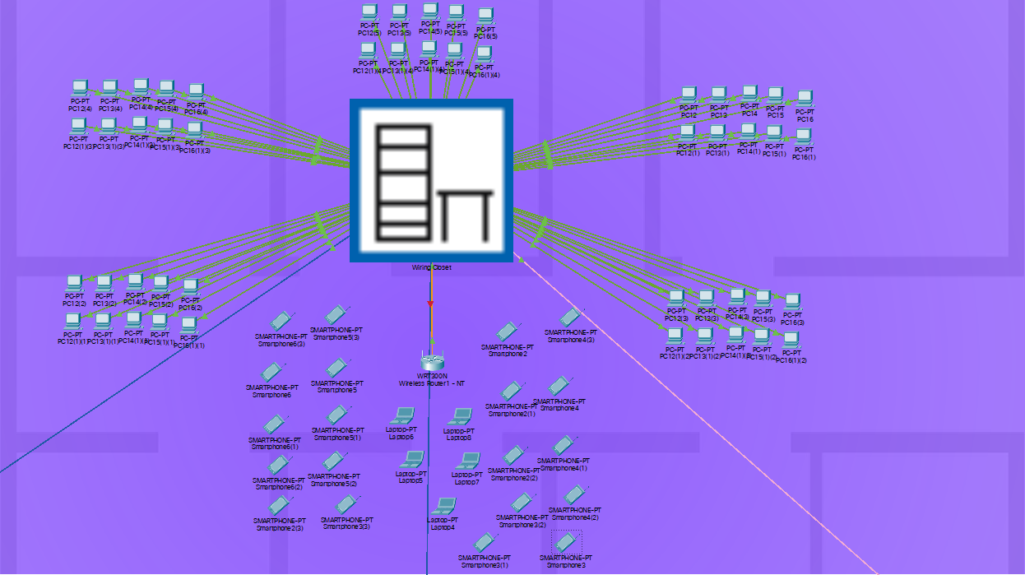
Wiring diagram
Nha Trang branch

Slide 33
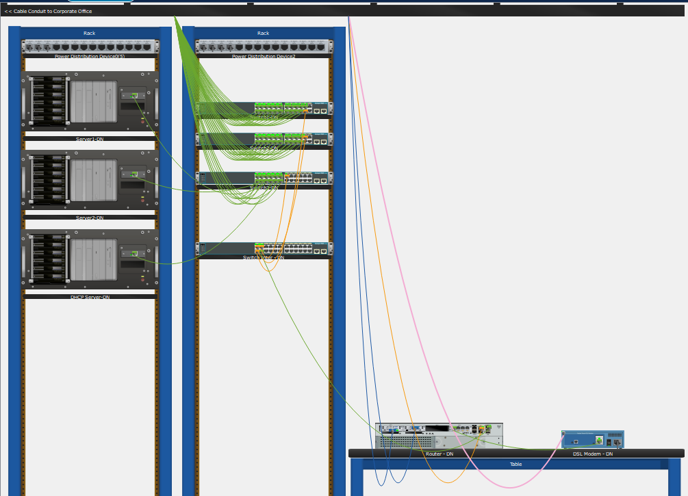
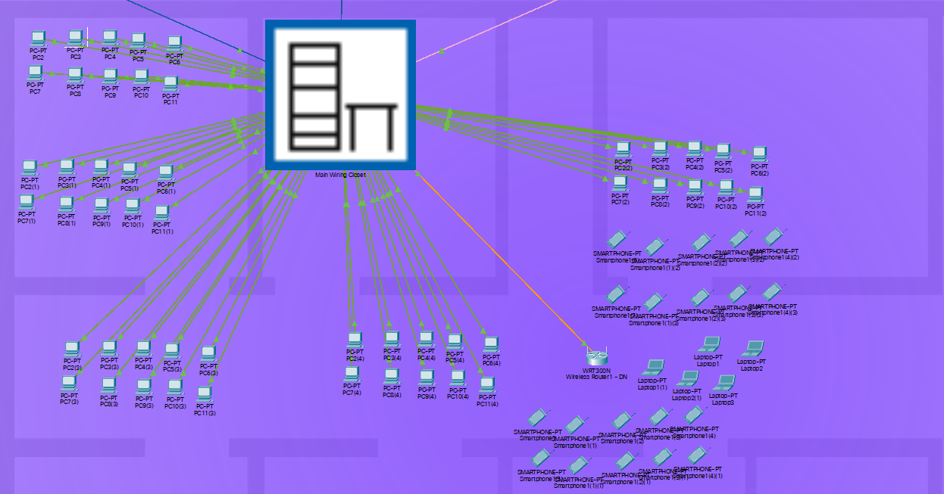
Wiring diagram
Da Nang branch

Slide 34
Calculation
04

Slide 35
Overview
The flows and load parameters of the system reach the peak at about 80% at two specific durations in a day (9 a.m.-11 a.m. and 3 p.m.-4 p.m. => 3 hours total) and can be shared for Head Office and Branches as follows:
Server: 500 MB/day
Workstation: 100 MB/day
Wifi-connected laptop: 50 MB/day
Assumption: The bank opens 8 hours a day (8 a.m. to 4 p.m.).

Slide 36
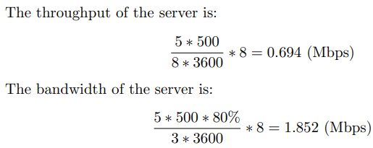
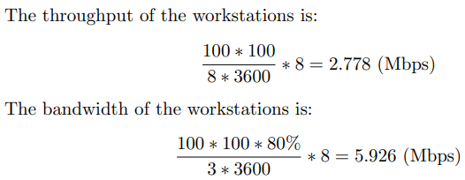
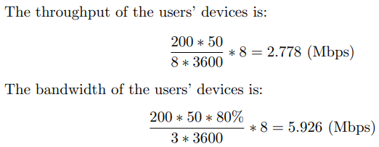
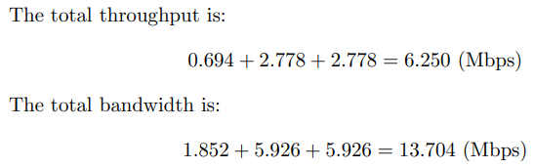
Headquarters
Headquarters in Ho Chi Minh City contains 5 servers and 100 workstations. Assume that there are about 200 customers visiting the headquarter pers day and 100 customers in peak time.

Slide 37
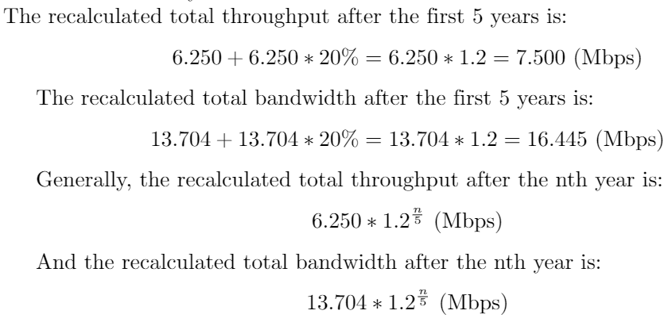
Headquarters
Safety parameters: Due to the growth rate of 20% every 5 years, the total throughput and total bandwidth need to be recalculated. After the first 5 years, since the bank was established, these two parameters increase by 20%. After the second 5-year period, these two parameters increase by 20% one more time and so on.

Slide 38
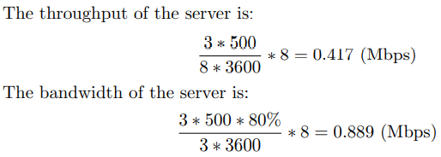
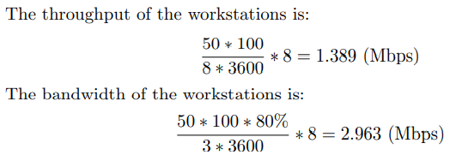
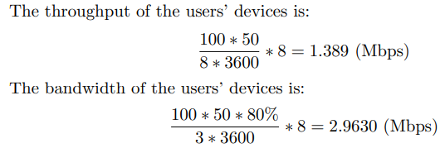
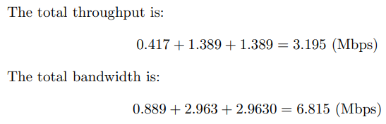
Branch
In terms of Branches in Nha Trang City and Da Nang City, each branch contains 3 servers and 50 workstations. Assume that there are about 100 customers visiting each branch per day and 50 customers in peak time.

Slide 39
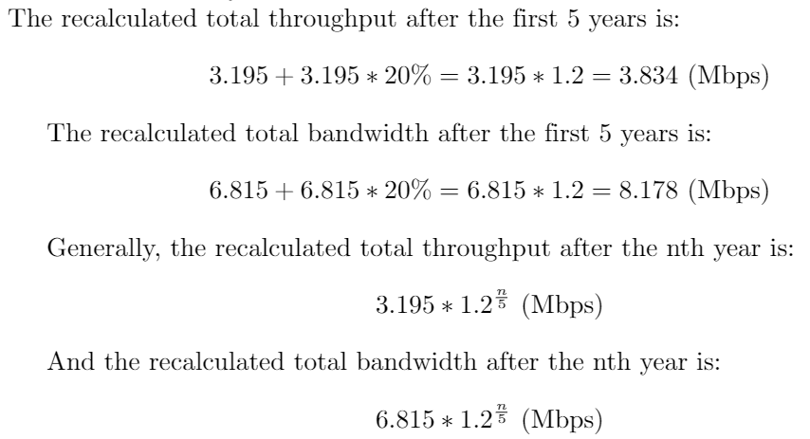
Branch
Safety parameters: Due to the growth rate of 20% every 5 years, the total throughput and total bandwidth need to be recalculated. After the first 5 years, since the bank was established, these two parameters increase by 20%. After the second 5-year period, these two parameters increase by 20% one more time and so on.

Slide 40
Packet Tracer
05

Slide 41
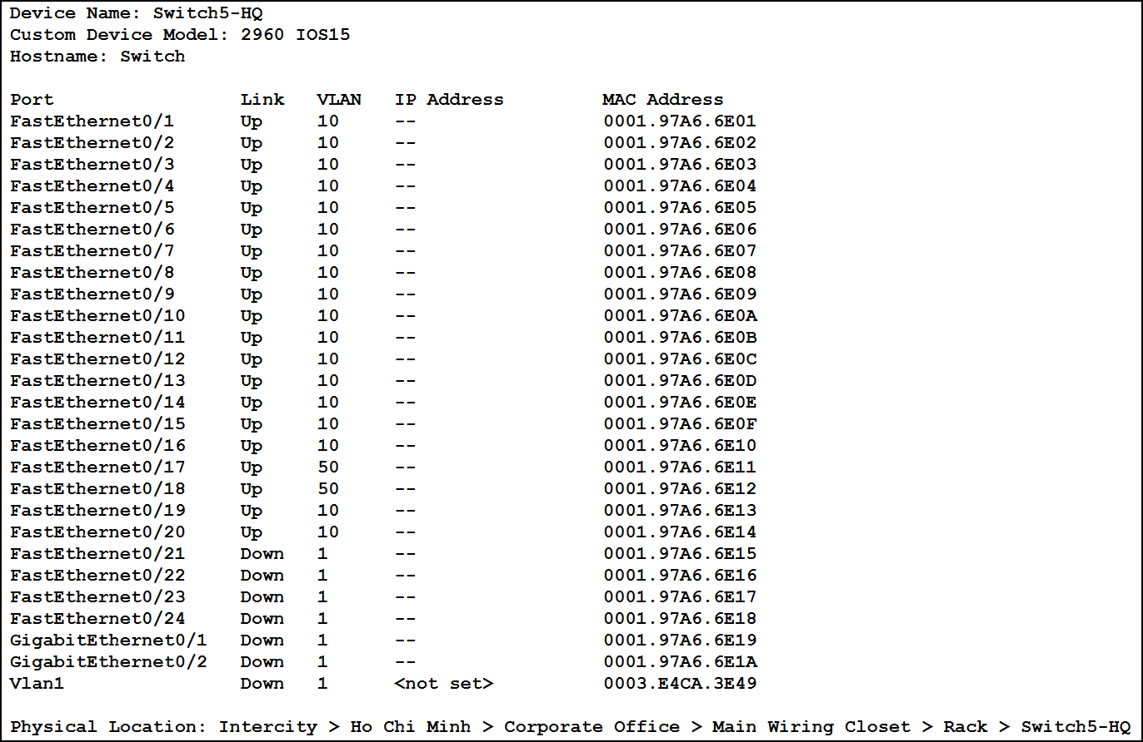
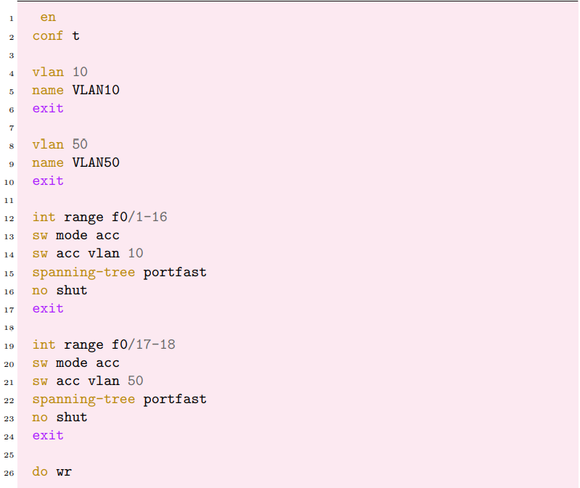
Switch and VLAN Configuration
VLAN 10: Workstations and DHCP servers.
VLAN 50: Servers.

Slide 42
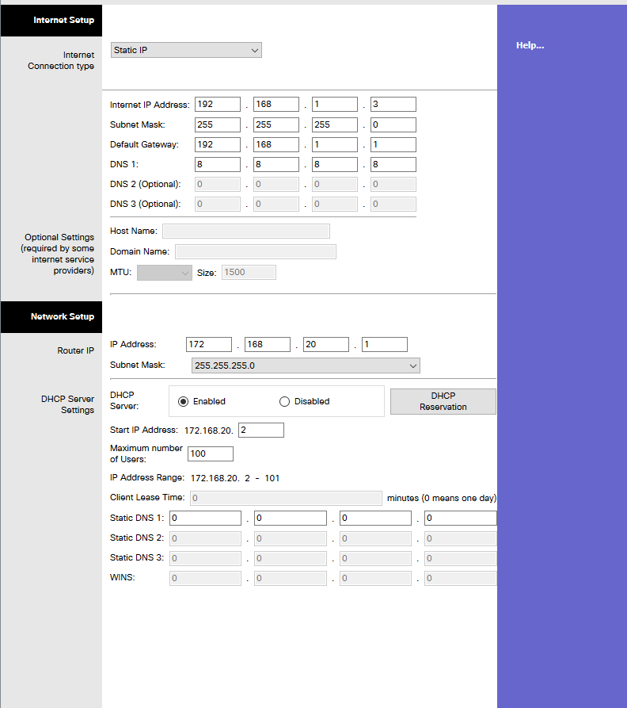
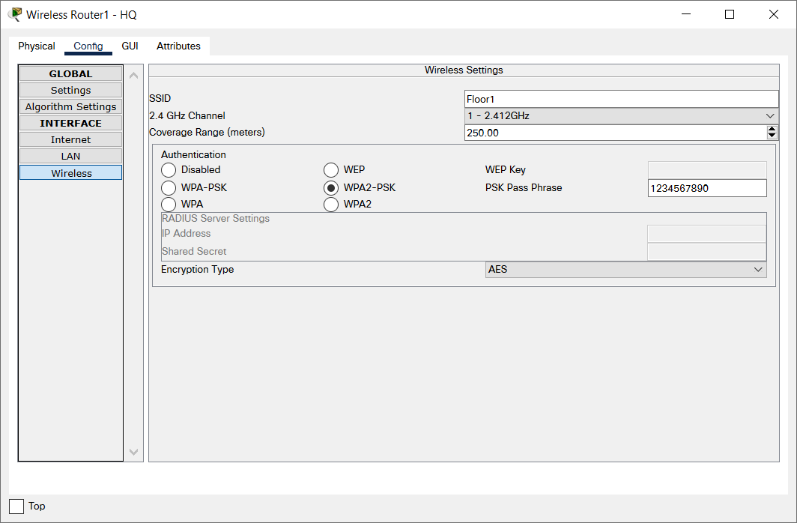
Wireless Router Configuration

Slide 43
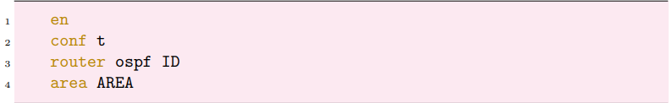
OSPF Protocol Setup
The connection between the Headquarters and the Branches can be enhanced by using OSPF protocol.
where ID depends on the area.
We let AREA = 0 as these routers are of the backbone area. Next, the ID is set to 1 for the Headquarters, 2 for the Nha Trang Branch, and 3 for the Da Nang Branch.

Slide 44
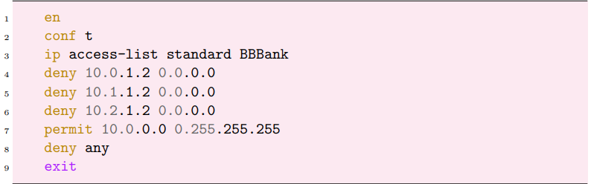
Security Setup
Use access control list (ACL) to limit the activity at the APs by prevent reaching the workstations from other area networks.
3 edge routers of the 3 buildings

Slide 45
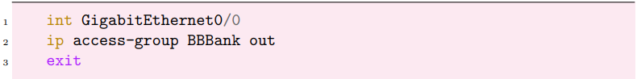
Security Setup
Use access control list (ACL) to limit the activity at the APs by prevent reaching the workstations from other area networks.
workstations

Slide 46
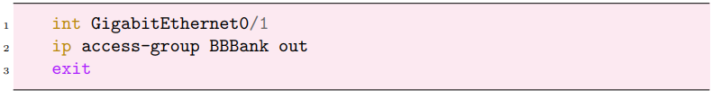
Security Setup
Use access control list (ACL) to limit the activity at the APs by prevent reaching the workstations from other area networks.
servers

Slide 47
Security Setup
Use access control list (ACL) to limit the activity at the APs by prevent reaching the workstations from other area networks.
Save configuration

Slide 48
System testing
06

Slide 49
System testing
Testing with Ping
Testing with Tracert

Slide 50
Result
07

Slide 51
Re-evaluation of the designed network system
Reliability
Ease of upgrade
Diverse support software
Safety
Security of data
Scalability

Slide 52
Remaining Problems
Scalability
Security

Slide 53
Development orientation in the future
Enhance security of the network to protect customer’s data.
Build a network security room to detect and resolve situations in real time.
Implement the ping from the internal network to the Web server.
When the bank grows larger, find strategies to improve the network at the lowest cost while maintaining good performance.

Slide 54
Conclusion
08

Slide 55
- Design a network for a real business - Apply theory for deeper understanding - Cisco packet tracer

Slide 56
Thank you!
Do you have any questions?

